Slide 1
19CSE 202 DBMS REVIEW 1 CAR RENTAL SYSTEM
Team Members:
S.NO | REG.NO | NAME | ROLE
1 | CB.EN.U4CSE1905 | A SATYA HEMANTH | TESTING AND DOCUMENTING
2 | CB.EN.U4CSE19449 | SAI KOUSHIK | DEVELOPER
3 | CB.EN.U4CSE19453 | ABHINAV RAVELLA | DESIGNER
4 | CB.EN.U4CSE19459 | SHANTHAN REDDY | LEADER

Slide 2
Problem definition
CAR RENTAL SYSTEM:
To design a website design to increase customer retention and to simplify vehicle and staff management.
The main objective of the website car Rental System requires a temporary vehicle, for example those who do not own their own car, or owners of damaged or destroyed vehicles who are awaiting repair or insurance compensation or travelers who are out of town.

Slide 3
Functionalities & Modules
Keeps track of different models vehicles in different locations.
A customer can check for all the availability of cars of his choice and book them.
Billing is done on returning of the car.
Certain caution deposit is taken before renting a car.
An admin can keep a track of all customers ,cars and car bookings.
We are proposing a WEBSITE DESIGN
End users:
Admin
Guest users
Registered users

Slide 4
What makes It special and unique?
EASY BOOKINGS
MOBILE READY
EASY ACCESS
AVAILBLE AT VARIOUS LOCATIONS
RECOMMENDATIONS AND FEEDBACK
SECURE PAYMENTS
CUSTOMER SERVICE

Slide 5
TABLES:
1.CUSTOMER
CUSTOMER(customer_id,location,customer_name,phone_number,Aadhar,Email,Gender,Date_of_birth)
DESCRIPTION:
The customers will need first to upload the necessary documents to verify their identity. The credentials uploaded by the customers will be stored in the table CUSTOMER.

Slide 6
2.CAR
CAR(car_id,customer_id,location,model,milage,seating_capacity,availability_status,reg_no)
DESCRIPTION:
Car information and details are recorded in the table CAR. It includes the model of the car, the capacity and registration no. The table CAR is linked to the CUSTOMER table through its foreign key (customer_id).

Slide 7
3.BOOKING:
BOOKING(booking_id,car_id, customer_id,location,amount,caution_deposit)
DESCRIPTION:
The booking details are stored in this table with primary key as booking_id and foreign keys of car_id , customer_id from the tables CAR and CUSTOMER respectively.

Slide 8
4.BILLING:
BILLING(billing_id ,booking_id,billing_date,discount,late_fee)
DESCRIPTION:
The billing details are stored in this table with billing_id as primary key and booking_id as foreign key from BOOKING table

Slide 9
5.DATE:
DATE(booking_id,billing_id,from_date,return_date,to_date)
DESCRIPTION:
Dates are stored in this table with booking_id and billing_id as foreign keys from BOOKING and BILLING tables respectively.

Slide 10
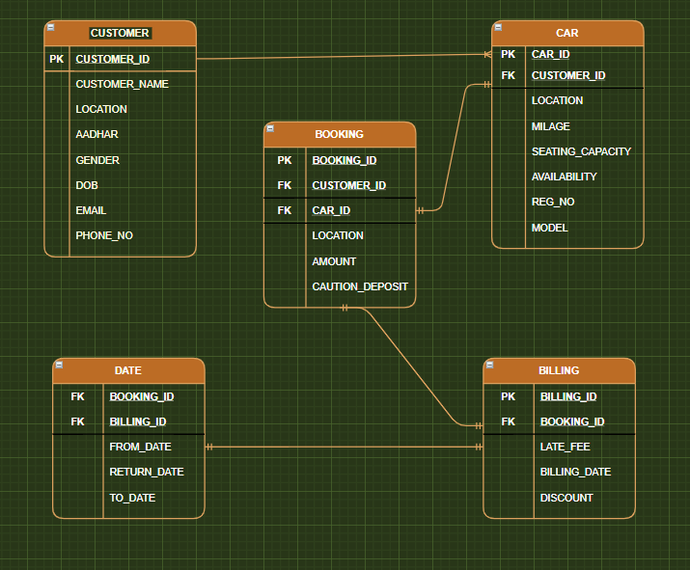
Schema

Slide 11
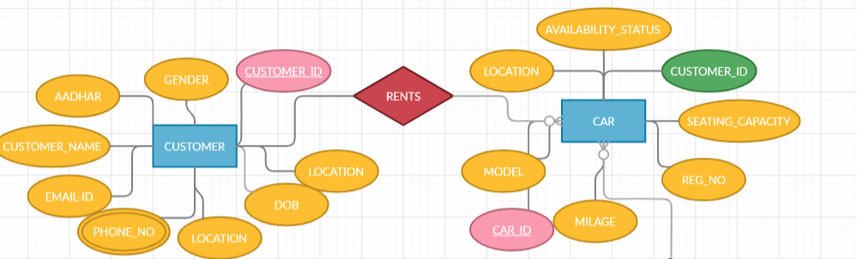
CUSTOMER-CAR

Slide 12
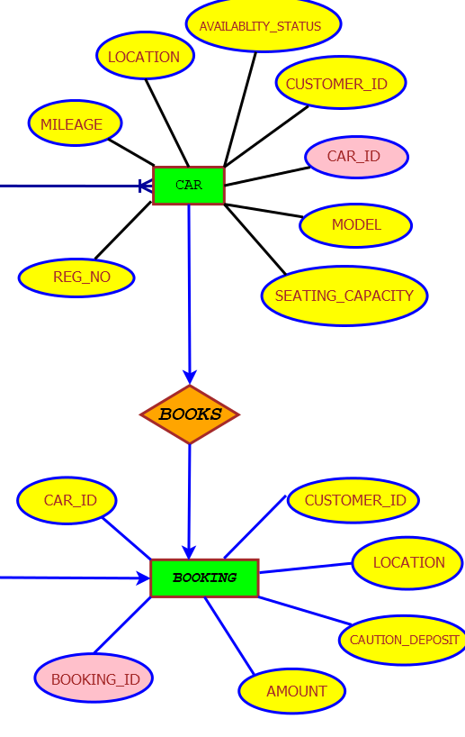
CAR-BOOKING

Slide 13
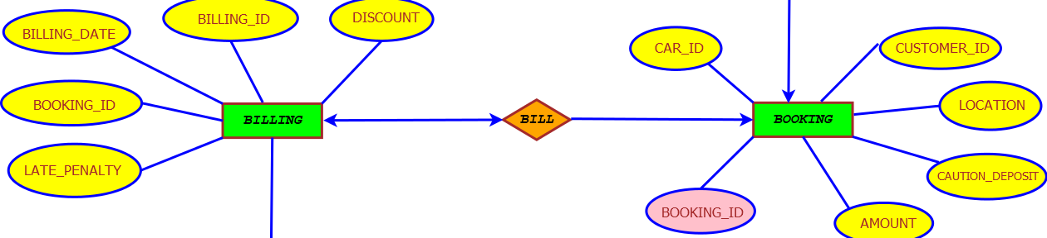
BOOKING-BILLING

Slide 14
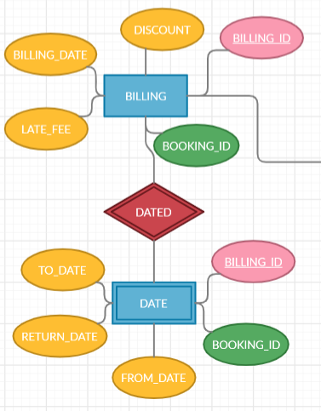
BILLING-DATE

Slide 15
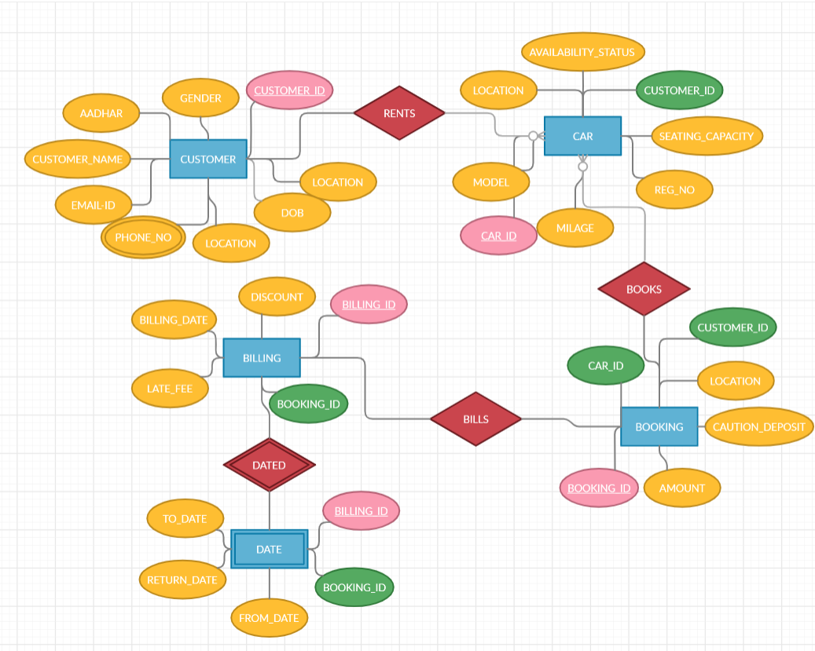
ENTITY RELATION DIAGRAM

Slide 16
Software/Tools Requirements
JAVA/JAVASCRIPT - USER INTERFACE
SQL - FOR DATABASE

Slide 17
THANK YOU

